Slide 1
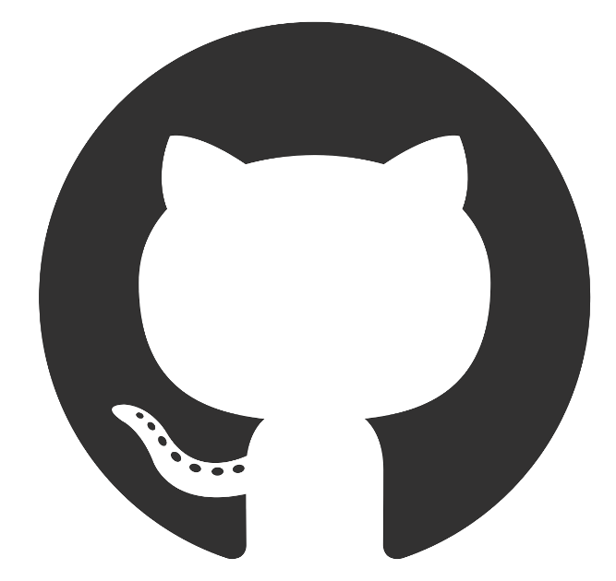



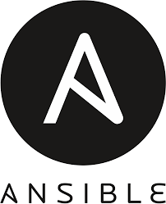


Code pushed to GitHub repository
Update Trello board
Most recent code pulled from GitHub repository
Pull new task from Trello board
Code built via web hook on build server
Coverage reports produced from results of unit testing
Code moved onto testing
Pipeline builds images from latest code pulled from web hook and pushes to Docker Hub
Pipeline configures environment and installs Ansible on master machine
Ansible configures manager and worker nodes for docker swarm
Docker swarm deploys containers within a cluster across multiple VMs
NGINX used as a reverse proxy

